Slide 1

Bank Marketing Campaign
Adelade Dube
Neelam Gupta
Priyanka Ukhale
Stecy Quenum
Suhail Bari

Slide 2
Content
Introduction
Data Description
Null and Missing value handling
Exploratory Data Analysis
Feature Analysis
Data Modelling
Decision Tree Classifier
Logistic Regression
Support Vector Machine
Model comparison

Slide 3
Introduction
The dataset is a secondary dataset from a Portuguese bank.
The data is enriched by the addition of five new social and economic features/attributes (national wide indicators from a ~10M population country), published by the Banco de Portugal
The data is about a bank's marketing campaign that offers clients a term deposit in the bank. The company approached its clients mostly by telephone and a target variable was assigned according to the client answers yes for offer acceptance and no otherwise.
If after all marking efforts, the client agrees to place deposit - target variable marked 'yes', otherwise ‘no’
http://archive.ics.uci.edu/ml/datasets/Bank+Marketing

Slide 4
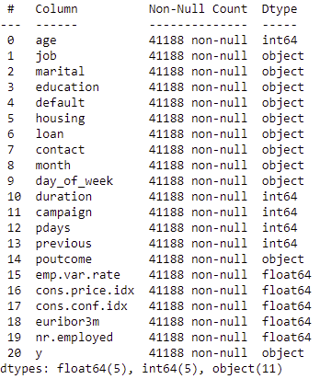
Data description
The dataset has 41188 rows, 21 columns that is 20 independent variables and target variable y
age (numeric)
job : type of job (categorical)
marital : marital status (categorical)
education (categorical)
default: has credit in default? (categorical)
housing: has housing loan? (categorical)
loan: has personal loan? (categorical)
contact: contact communication type (categorical)
month: last contact month of year (categorical)
dayofweek: last contact day of the week (categorical)
campaign: number of contacts performed during this campaign and for this client (numeric)
pdays: number of days that passed by after the client was last contacted from a previous campaign (numeric)
previous: number of contacts performed before this campaign and for this client (numeric)
poutcome: outcome of the previous marketing campaign (categorical)
social and economic context attributes
emp.var.rate: employment variation rate - quarterly indicator (numeric)
cons.price.idx: consumer price index - monthly indicator (numeric)
18. cons.conf.idx: consumer confidence index - monthly indicator (numeric)
19. euribor3m: euribor 3 month rate - daily indicator (numeric)
20. nr.employed: number of employees - quarterly indicator (numeric)
Output variable (desired target):
21 - y - has the client subscribed a term deposit? (binary)

Slide 5
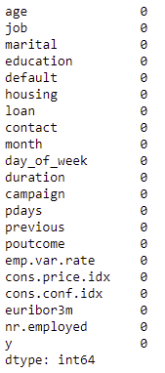
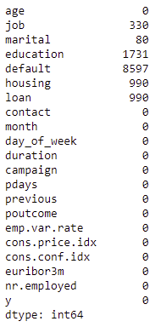
NULL and missing values handling
The dataset does not contain NULL values but has ‘unknown’ values
We can see that the ‘default’ column has several missing values. However, we will not be using the column in the analysis.
There are very few missing values as compared to the entire dataset. We will be dropping the values.
NULL VALUES
MISSING VALUES

Slide 6
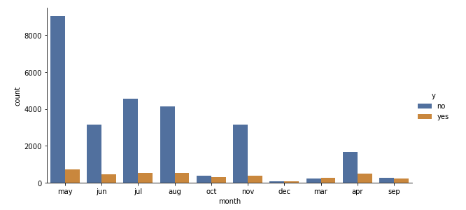
Exploratory data analysis
In the below bar plot, we explore the month variable with respect to the target variable y.
We see a high rate of decline in the month of May.
The month of May is the best for doing business though.
The later half of Q1 and Q2 see the highest activity.

Slide 7
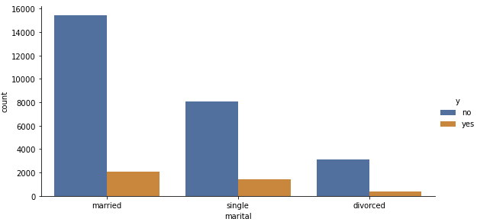
Exploratory data analysis
In the below bar plot, we explore the marital variable with respect to the target variable y.
We see that most of the outreach is aimed towards married folk, whether its intentional or not.
We see that the conversion rate of singles is higher than married or divorced folk.

Slide 8
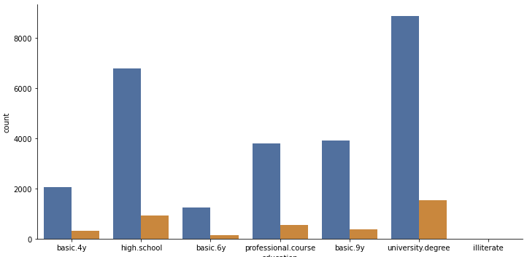
Exploratory data analysis
In the below bar plot, we explore the education variable with respect to the target variable y.
We see that most of the people who have a good conversion rate are degree holders or high schoolers.

Slide 9
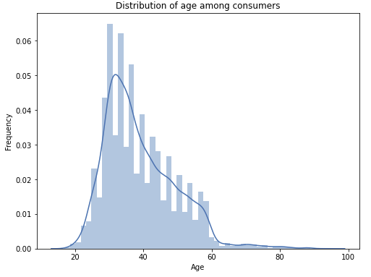
Exploratory data analysis
In the below bar plot, we explore the distribution of age among the customers.
We see that most of the people who have a good conversion rate are degree holders or high schoolers.
The mean of the distribution is 39.03

Slide 10
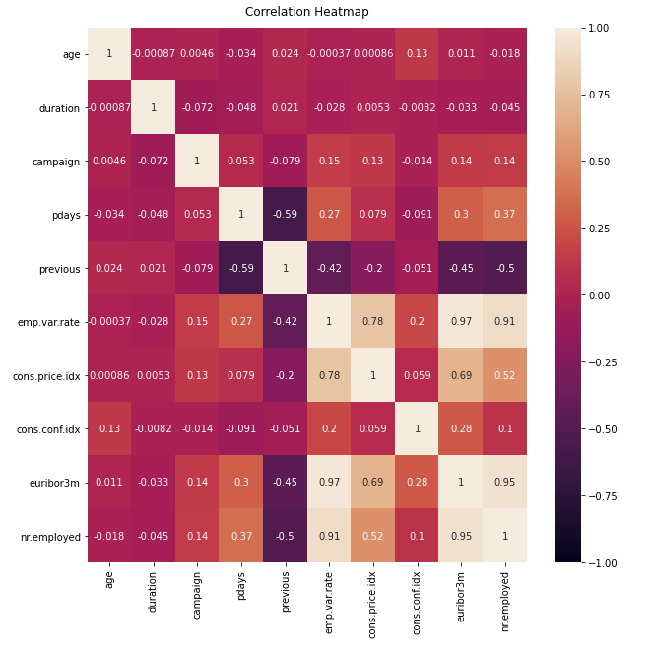
Feature analysis
We first establish the relationship amongst numeric variables to detect multicollinearity
-1 indicates a perfectly negative linear correlation between two variables
0 indicates no linear correlation between two variables
1 indicates a perfectly positive linear correlation between two variables
The further away the correlation coefficient is from zero, the stronger the relationship between the two variables.

Slide 11
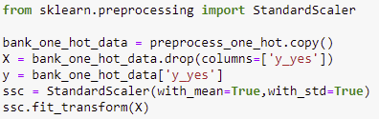

Data modelling
Since most of our data contains categorical variables, we use the one hot encoding technique to model our data.
Using this encoding and allowing the model to assume a natural ordering between categories may result in poor performance or unexpected results (predictions halfway between categories)
Split test and train datasets into 80:20.

Slide 12
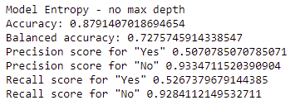

Decision tree classifier
Decision Tree algorithm belongs to the family of supervised learning algorithms.
The goal of using a Decision Tree is to create a training model that can use to predict the class or value of the target variable by learning simple decision rules inferred from prior data(training data)
MSE = 0.1208
RMSE = 0.3476

Slide 13

Logistic regression
Logistic Regression is one of the most popular Machine Learning Algorithms, used in the case of predicting various categorical datasets.
For the best fit of categorical datasets, a Curve is being required which is being possible with the help of Logistic Regression, as it uses a Sigmoid function to make predictions.
Model accuracy = 0.9035
MSE = 17.507
RMSE = 0.3105

Slide 14
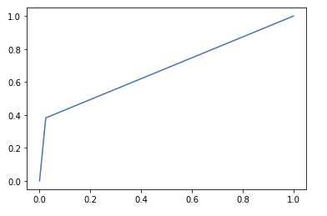
Support vector machine
Support Vector Machine or SVM is one of the most popular Supervised Learning algorithms, which is used for Classification as well as Regression problems. However, primarily, it is used for Classification problems in Machine Learning.
The goal of the SVM algorithm is to create the best line or decision boundary that can segregate n-dimensional space into classes so that we can easily put the new data point in the correct category in the future.
This best decision boundary is called a hyperplane.
Model accuracy = 0.9027
MSE = 0.097
RMSE = 0.3118

Slide 15
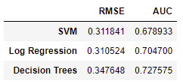
Model comparison
The RMSE is the square root of the variance of the residuals.
It indicates the absolute fit of the model to the data–how close the observed data points are to the model’s predicted values.
R-squared is a relative measure of fit, RMSE is an absolute measure of fit. RMSE can be interpreted as the standard deviation of the unexplained variance and has the useful property of being in the same units as the response variable.
The RMSE is a good measure of how accurately the model predicts the response, and it is the most important criterion for fit if the main purpose of the model is prediction.
The lower the RMSE value, the better the model. So, the Regression model is a better performer in this case.

